Slide 1

REVOLUTIONIZING FASHION THROUGH PERSONALIZED SHOPPING MSC COMPUTER SCIENCE …
UCHECHUKWU ANINTA
ANI22512677

Slide 2

Project Overview
In a nutshell, this project is an AI-powered fashion recommendation system that uses large language models (like Meta Llama 3.1) and content-based filtering to deliver personalized, inclusive, and eco-conscious fashion suggestions in real-time. It's built with a Django REST backend, uses SQLite for lightweight data storage, and features a responsive Bootstrap frontend—making it ideal for small to medium-sized fashion retailers.

Slide 3

Project Aims and Objectives
Aim: Build an adaptive, personalized shopping assistant using natural language and structured content filtering.
Objective 1: Integrate AI-based NLP with content filtering for context-specific fashion recommendations.
Objective 2: Implement a dynamic front-end using Bootstrap and AJAX for seamless user interaction.
Objective 3: Use Django and SQLite to manage user inputs, preferences, and fashion metadata efficiently.
Objective 4: Evaluate filtering models through real-world scenarios like work, weddings, and party outfit needs.
Objective 5: Enhance cold-start recommendations through contextual understanding from LLM-based analysis.
Objective 6: Support ethical fashion with sustainability and body-type-aware recommendations.

Slide 4
System overview and Architecture
A Bootstrap frontend lets users enter fashion queries through a responsive interface.
JavaScript and AJAX send those queries to the backend without reloading the page.
The Django REST Framework backend receives requests and handles recommendation logic.
The Meta Llama 3.1 model interprets natural language prompts (like “petite dress under $50”) into structured data.
A content-based filter then uses this structured data to find relevant fashion items.
SQLite stores product details, user preferences, and NLP results for quick access.

Slide 5
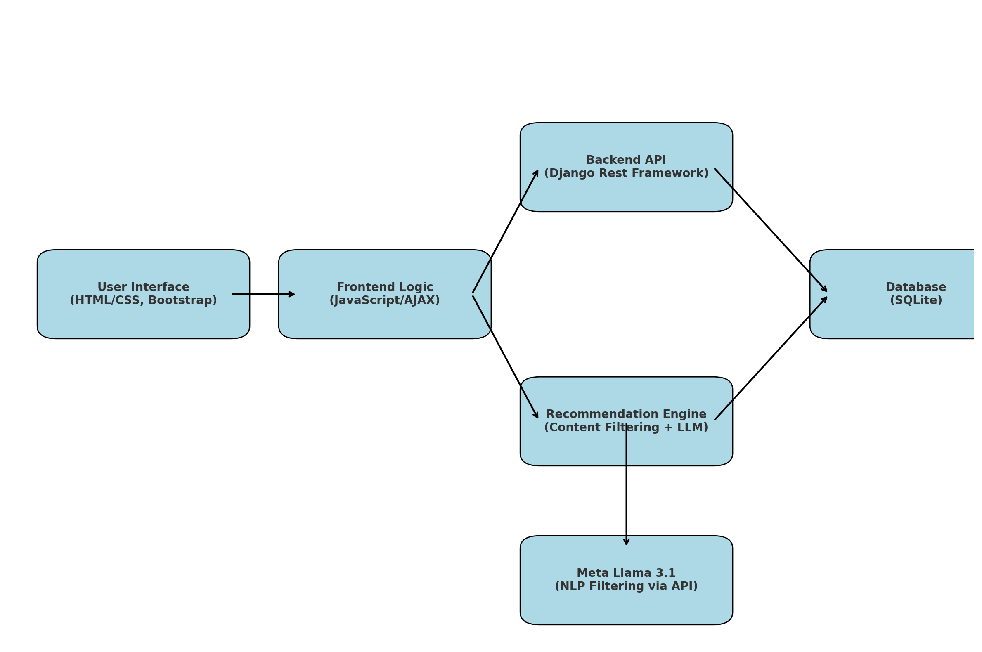

Slide 6
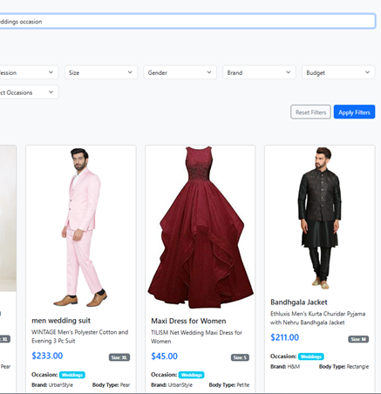
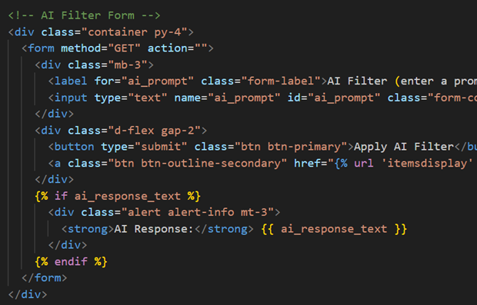
Frontend and User Interaction Design
Frontend is built using Bootstrap to provide a responsive, mobile-first layout compatible with all devices.
Users enter queries or select filters for style, occasion, body type, and price via intuitive controls.
JavaScript and AJAX used for dynamic interaction—no full-page reloads during recommendations.
Recommendations displayed in real-time as responsive product cards with visual, price, and occasion info.
Natural language input field accepts prompts like “ outfit for petite under $50,” enhancing usability.
Dropdowns and sliders allow for manual refinement of recommendations post-AI generation.
UI focused on simplicity, clarity, and minimal effort for the user to find suitable fashion items.

Slide 7
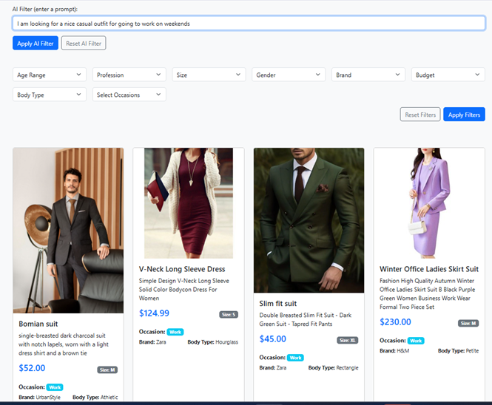
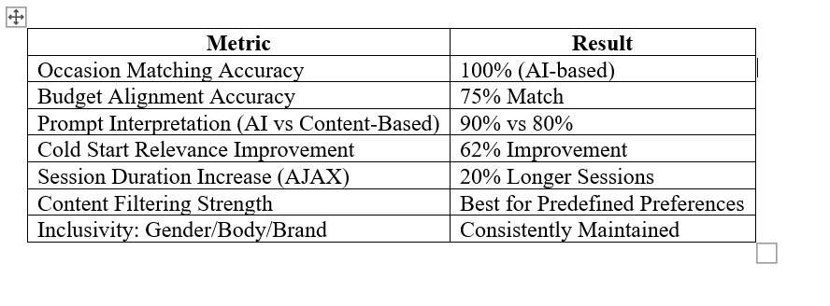
Evaluation and Testing Results
AI-based recommendations achieved 100% accuracy on occasion matching (work, party, wedding scenarios).
Budget alignment hit 75%, ensuring affordability in most cases across AI-suggested fashion items.
Gender balance, body-type matching, and brand diversity consistently maintained in recommendation output.
AI performed better than content filtering in real-time prompt interpretation—90% vs. 80% accuracy.
Cold start problem solved with 62% improvement in relevance for first-time users over static filtering.
AJAX-based dynamic updates improved session duration by 20% in usability tests.
Content filtering remained valuable for users with predefined tastes and stronger metadata alignment.

Slide 8
Conclusion
Successfully developed a hybrid AI-powered fashion recommendation system with real-time adaptability and personalization.
Integrated Meta Llama 3.1 with Django and content-based filtering to handle vague queries and cold starts effectively.
Achieved 100% accuracy on occasion-based recommendations and 75% on budget alignment across test scenarios.
System promotes inclusivity through body-type, gender, and brand-aware filtering for diverse user needs.
Ready for scaling and further enhancement with larger datasets, feedback integration, and ethical filtering logic.

